Slide 1


Capstone Project
Appliances Energy Prediction
Presented By:
Shubham Kumar

Slide 2
Problem Statement
Goal :
The goal of our project is to predict the energy consumption of appliances in households based on the sensor data we have from a particular apartment and corresponding weather reports.
Why is this important ?
We need to find out the energy consumption of households in the city so as to ensure that the amount of electricity fed into the electricity grid is always be equal to the amount of electricity consumed, otherwise there's a possibility of black out.
How is that?
If too much electricity is fed into the grid in relation to the quantity consumed, the electrical frequency increases. Since power plants are designed to operate within a certain frequency range, there is a risk that they will disconnect from the grid after a period of time.
If we feed in too little to meet demand, the frequency drops. From 49 Hz, the automatic load shedding plan is activated in order to avoid power cuts. This is because, if the frequency falls too much, the power plants switch off one after another, until there is a complete collapse of the grid, i.e. a power blackout.

Slide 3
Data Summary
The dataset we have is a series of sensor data collected from a building in Belgium at an interval of 10 mins for a period of about 4.5 months.
The sensor data consists of temperature and humidity levels in different rooms in the building.
Among other features are weather reports on Pressure, Wind speed, Visibility and T-dew point, which are recorded at weather station Chievres Airport, Belgium.
The target variable is the total energy consumption of the building in Wh.
The dataset has no null values.

Slide 4

Exploratory
Data Analysis

Slide 5
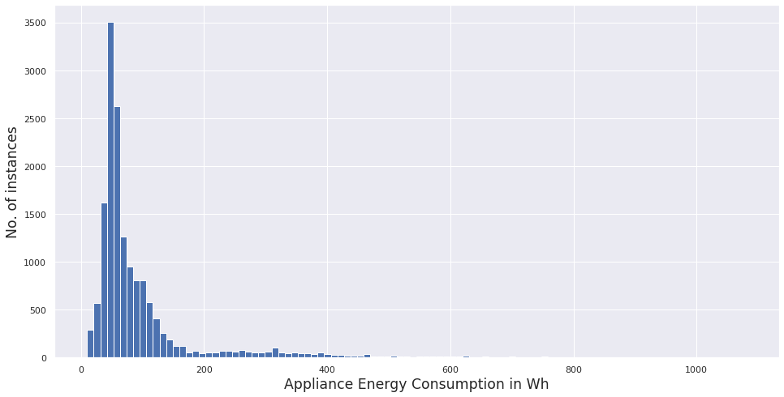
Target Variable
Energy consumption of appliances ranges from 10 Wh to 1080 Wh
About 75 % of energy values lie below 100 Wh, and about 93 % of them lie below 300 Wh
Our target variable seems to be highly skewed, and our task is to predict the usual as well as the large surges in energy in the building.

Slide 6
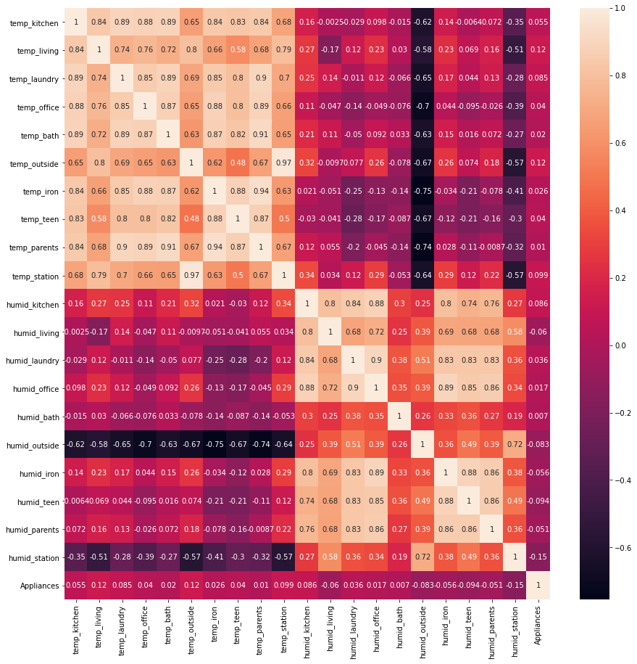
Correlation matrix
The Temperature and humidity levels in each of the rooms are highly correlated among themselves.
There seems to be no relationship between humidity and temperature levels in the building.
However temperature and humidity levels outside the building are hugely negatively correlated.
There is little to no correlation between these features and the target variable i.e. Appliance energy consumption

Slide 7
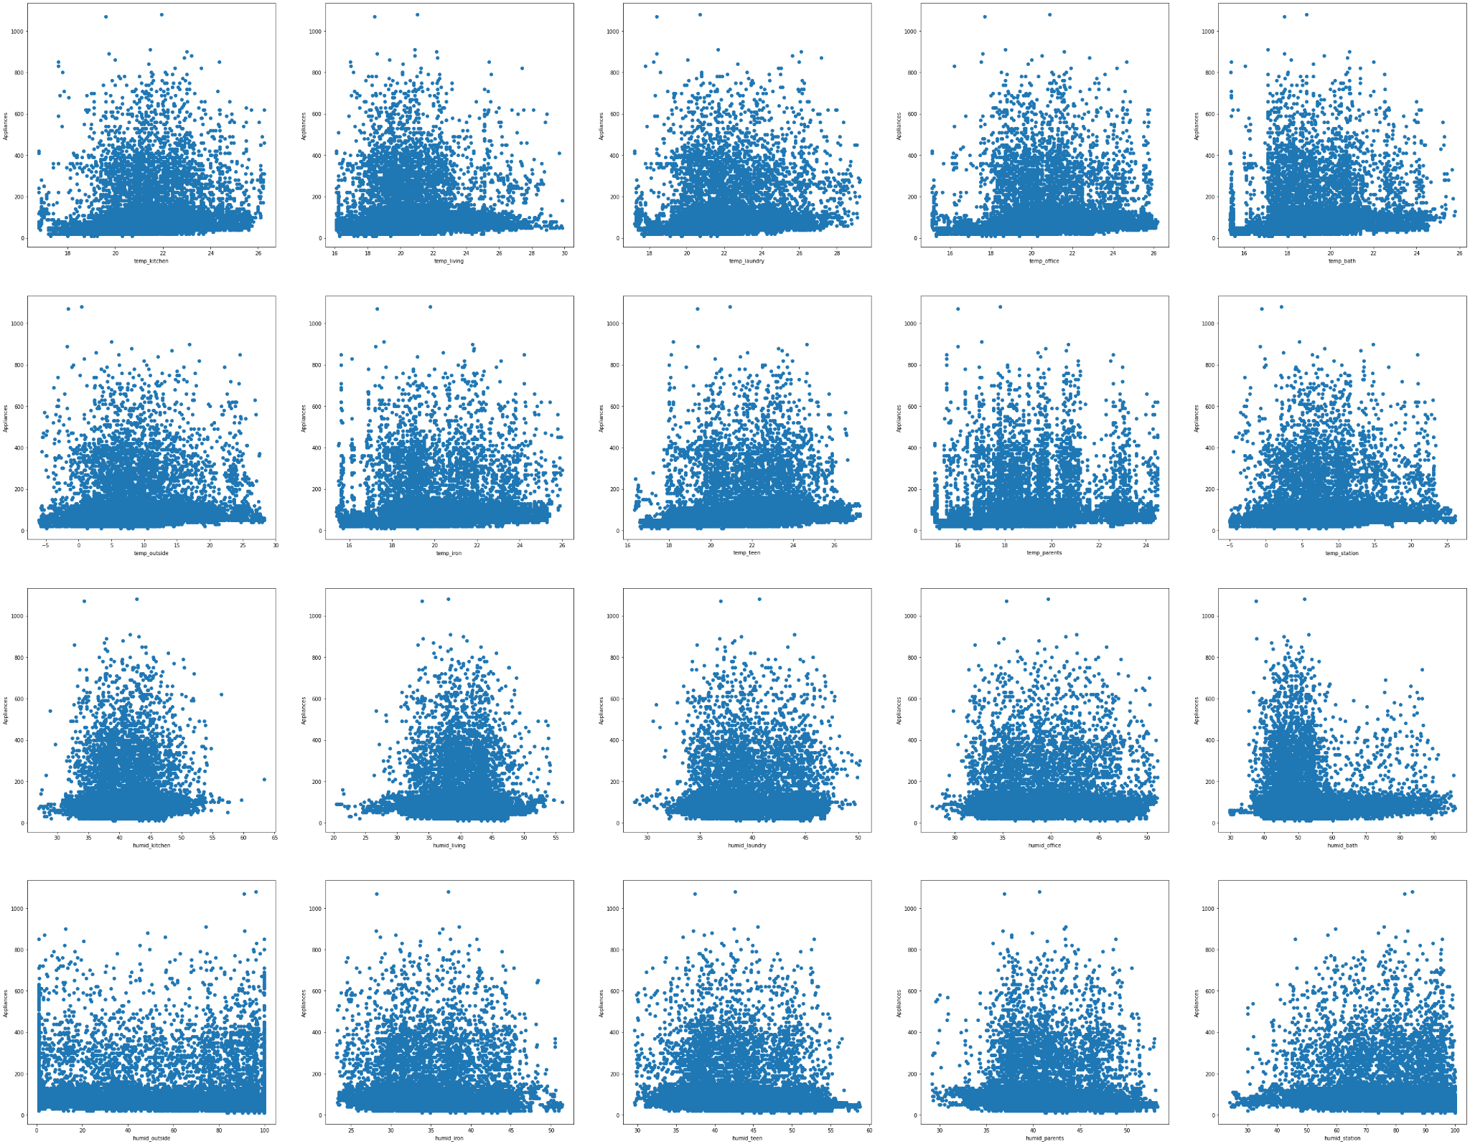

Slide 8
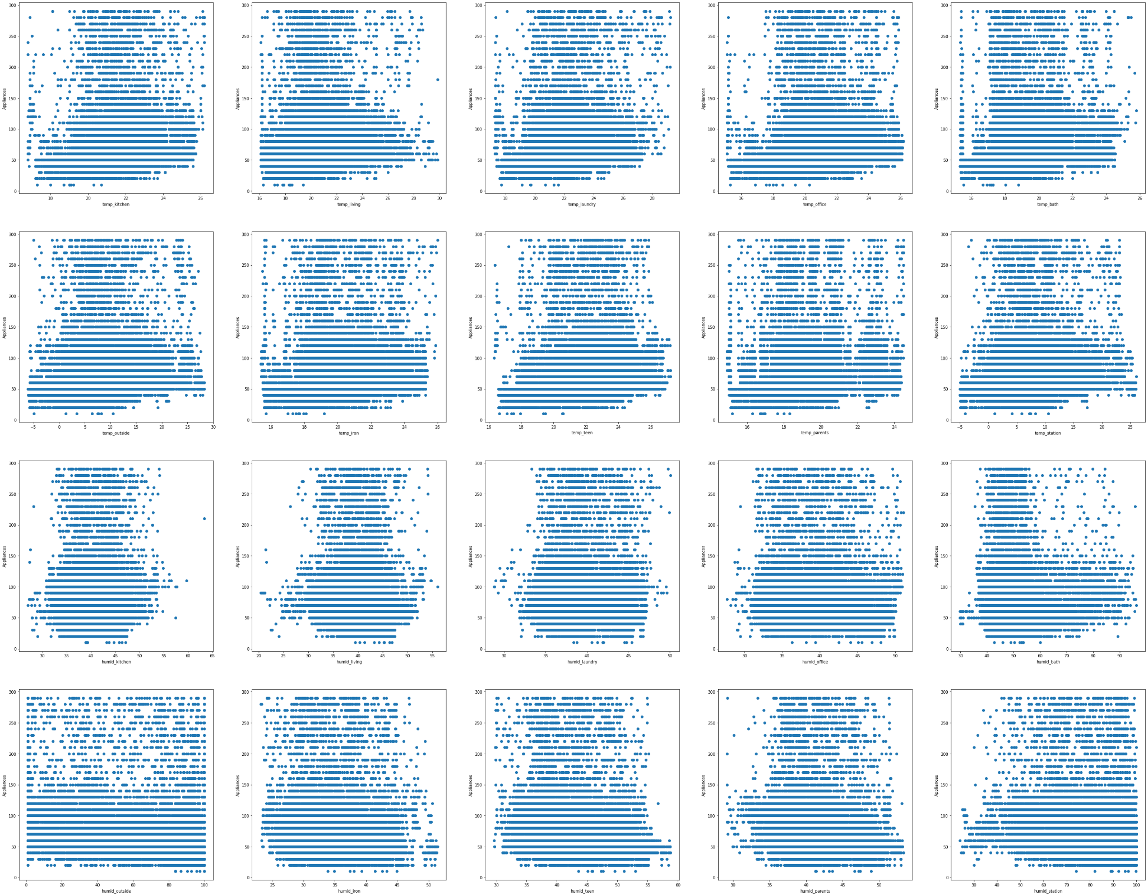

Slide 9

Feature Engineering

Slide 10
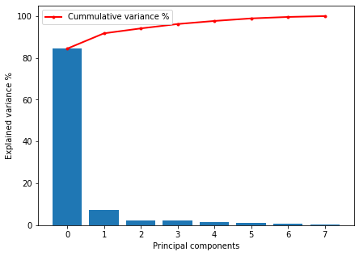
Principal component Analysis
Given, temperature levels in different rooms had a very low correlation with target variable, and high correlation among themselves, we reduce the feature set into lower dimensions that could explain maximum variance.
PCA 1 and 2 explain more than 91 % variance in the temperature levels in different rooms in the building

Slide 11
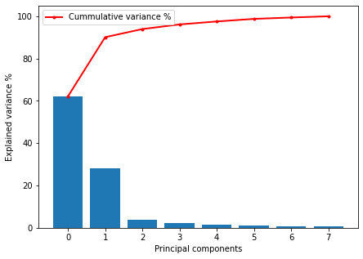
Principal component Analysis
Given, humidity levels in different rooms had a very low correlation with target variable, and high correlation among themselves, we reduce the feature set into lower dimensions that could explain maximum variance.
PCA 1 and 2 explain more than 91 % variance in the humidity levels in different rooms in the building

Slide 12
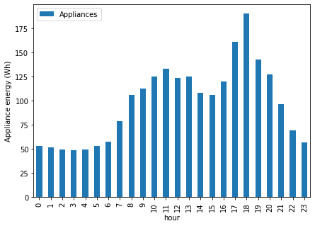
Date time (Hour)
We have column called date which includes the timestamp corresponding to each of the sensor data sample.
There seems to be a pattern to energy consumption of appliances at different time of the day.
Morning 11 AM and evening 6 PM seem to be peak hours.

Slide 13
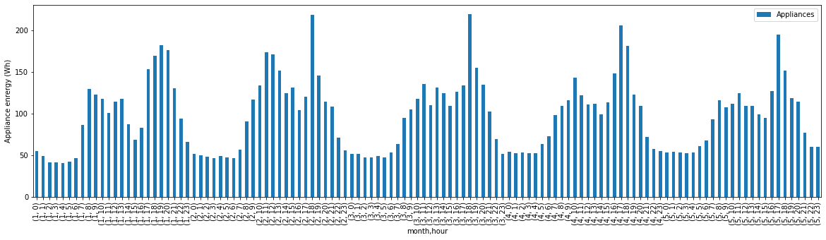
Date time (Month)

Slide 14
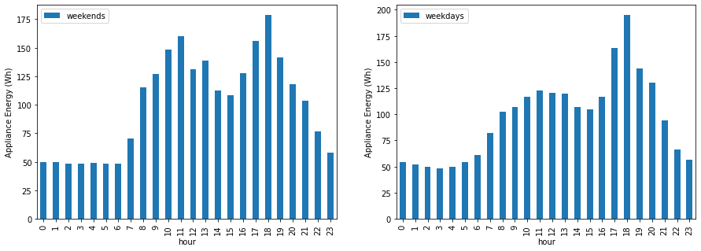
Date time (Weekday)

Slide 15
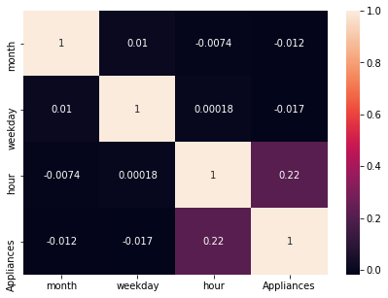
Correlation
There is no significant correlation between month and the appliance energy consumption, as we saw the pattern of consumption was almost similar over all months.
Same is the case for weekdays and weekends.
However, there is a significant correlation between hours and the target variable.

Slide 16
Session
We divided the dataset into 3 sessions :
Class 1 : 10 PM - 6 AM
Class 2 : 6 AM - 3 PM
Class 3 : 3 PM - 10 PM

Slide 17
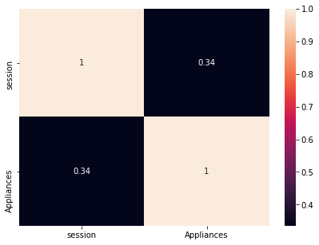
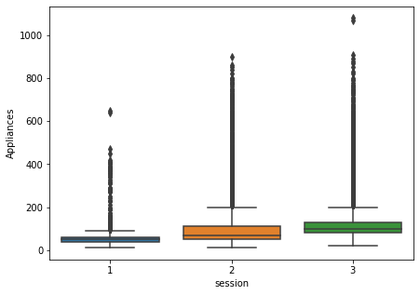
Session

Slide 18
Final Features
Feature set - I
Session
Temperature - pca 1
Temperature - pca 2
Humidity - pca 1
Humidity - pca 2
Temperature outside
Humidity outside
Pressure
Wind speed
Feature set - II
Session
Temperature of all rooms inside building
Humidity of all rooms inside building
Temperature outside
Humidity outside
Pressure
Wind speed

Slide 19
Model Training and Evaluation

Slide 20
Models trained
Lasso and Ridge regression
Random Forest Regressor
Extra trees Regressor
Gradient boosting regressor
XG-Boost Regressor
K Neighbours Regressor
Support Vector Regressor
MLP regressor (Neural networks)

Slide 21
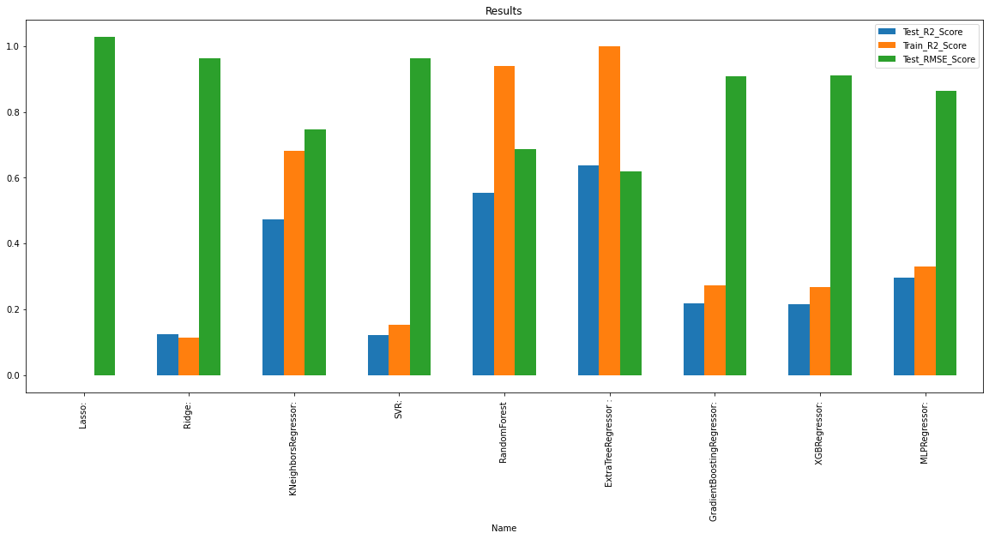
Results (with PCA features)

Slide 22
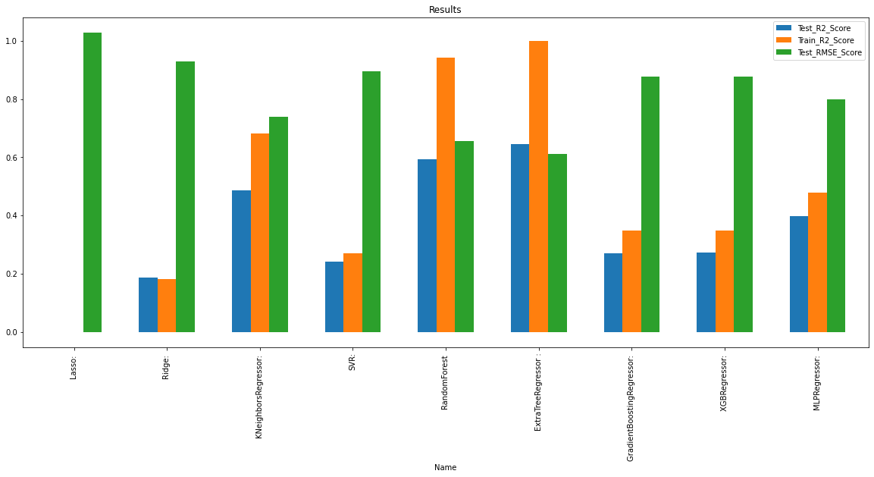
Results (without PCA features)

Slide 23
Best Performing Model
Both feature set with or without PCA features perform equally well on our selected tree-based model.
Although, Extra trees regressor overfits our training data with a r2 score of 1, it also gives, by far, the best performance on test set as well compared to other models, with a R2 score of 0.645.
The test RMSE is also comparatively too low compared to other models.
Hyper parameter tuning of our model doesn’t have any significant impact on our test results. We were able to improve the test R2 score results by less than 1%.

Slide 24
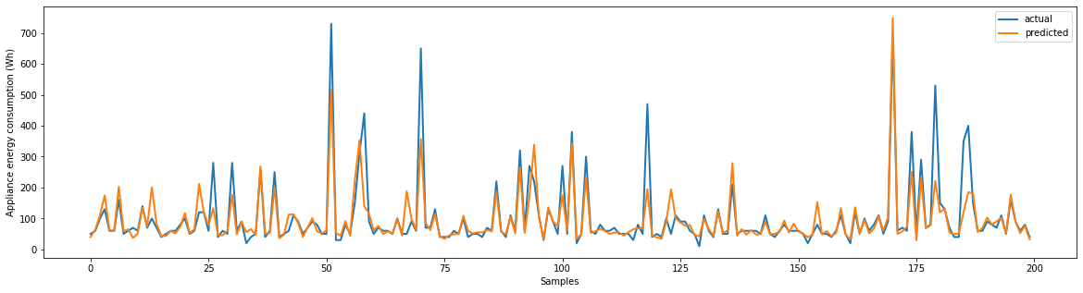
Analysis of our model

Slide 25
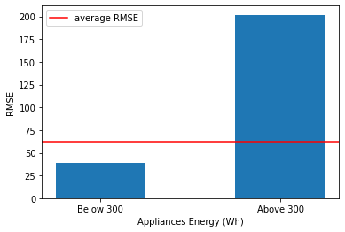
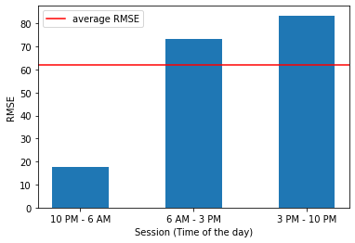
Analysis of our model

Slide 26
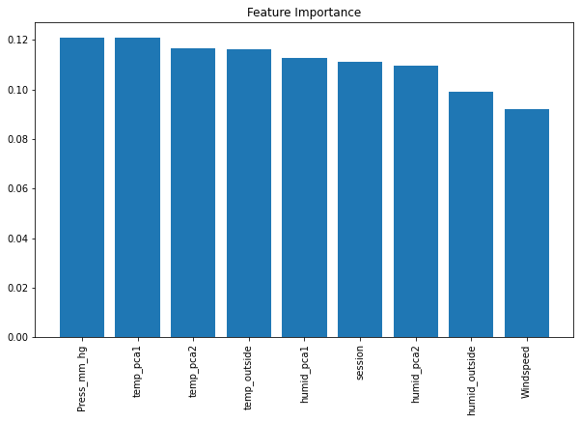
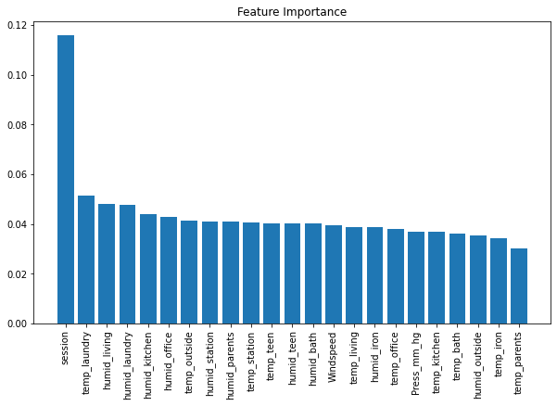
Feature importances

Slide 27
Conclusion
The temperature/ humidity features showed little to no linear (pearson) correlation w.r.t target variable (<1%), although being highly linearly correlated within themselves.
The time zone of the day plays an important role in deciding power consumption of appliances.
The best Algorithm to use for this dataset is Extra Trees Regressor (tree based algorithm)
PCA helped us to reduce our feature set dimension considerably without affecting performance of our models significantly.
The untuned model was able to explain 64.5% of variance (R2 score = 0.645) on test set, while the tuned model was able to explain 64.9% of variance (R2 score = 0.649) on test set which is a tiny improvement of < 1 %
The least RMSE score on test data set is found to be around 0.6 by Extra trees regressor model, which is considerably good compared to other models.
Tree based models are by far the best model while dealing with data set that has most of its features having no linear correlation with target variable. For similar reasons, linear models such as linear regression, Ridge and Lasso perform the worst.

Slide 28


